Slide 1
Baltimore 911 Call and Crime
Ben Schnoor
Petros Airapetyan
Carson Batchelor
Yuqing Zhao
Nanyi Jiang

Slide 2
Basic Information About Data Sets
We have 4 data sets:
First Baltimore dataset includes 3.6 million observations of 911 calls
Next Baltimore dataset includes data of crime and age/gender
New Orleans Dataset includes different observations of crime and their descriptions
United States Census Bureau includes population demographic and different observation estimates
Notes:
Welcome, everyone. Today we delve into Baltimore's public safety concerns, illuminated by four key datasets:
A comprehensive record of over 3.6 million 911 calls from Baltimore.
Data pairing crime incidents with age and gender demographics within the city.
Comparative crime descriptions from New Orleans, a city similar to Baltimore in size and socioeconomic makeup.
Population demographics and estimates from the United States Census Bureau.
These datasets are pivotal in our study of the relationship between population size and crime rates. They inform our recommendations for strategies such as increased policing in high-call areas and the incorporation of mental health services into public safety plans.
Utilizing Python and ARCGIS Pro, we'll integrate demographic data with crime statistics to provide a nuanced analysis that goes beyond numbers to reveal the story of a city striving for safety.
As we navigate this data, we'll touch on the nature of 911 calls, the demographic underpinnings of crime, and the comparative analysis with national data, all while seeking actionable insights for policy and community initiatives.
Let's start by dissecting these datasets and their implications for Baltimore's approach to reducing crime."

Slide 3
Research Question/Hypothesis
Our hypotheses serve as recommendations to the government aimed at enhancing urban safety, including initiatives such as increased police patrols in areas with high call volumes, the implementation of mental health and social services, and the adoption of data-driven policing strategies.

Slide 4
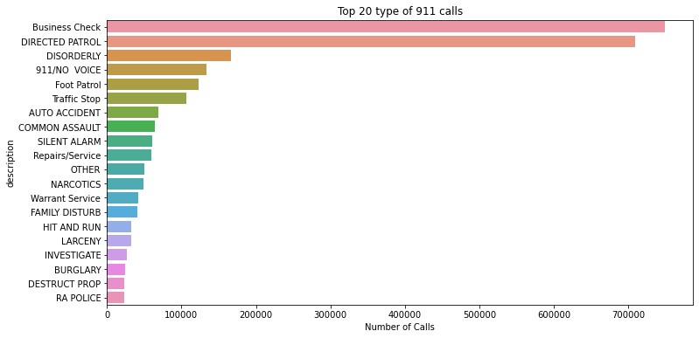
Basic Analysis
911 Call Analysis in Baltimore: Trends and Priorities"
Key bullet points ：
Downtown and Brooklyn lead in call volumes.
High call volumes correlate with high population density.
Directed patrols and business checks constitute the majority of calls.
Notes:
This bar graph shows Downtown and Brooklyn with the highest call volumes, likely linked to their dense populations and crime rates.
Most calls relate to business checks and directed patrols, with over 650,000 in 2021, reflecting proactive policing in crime hotspots.
Yet, there's a notable drop to about 200,000 for disorderly conduct and fewer for foot patrols and traffic stops. This tells us where police focus their preventive efforts.
Contrary to the expected summer crime spike, our data shows a peak in early year calls, decreasing by 33% towards the end. It's an unusual trend that prompts further investigation.
For tackling Baltimore's crime, analyzing call trends, descriptions, and priority levels informs resource allocation and community policing strategies tailored to our city's specific context."

Slide 5
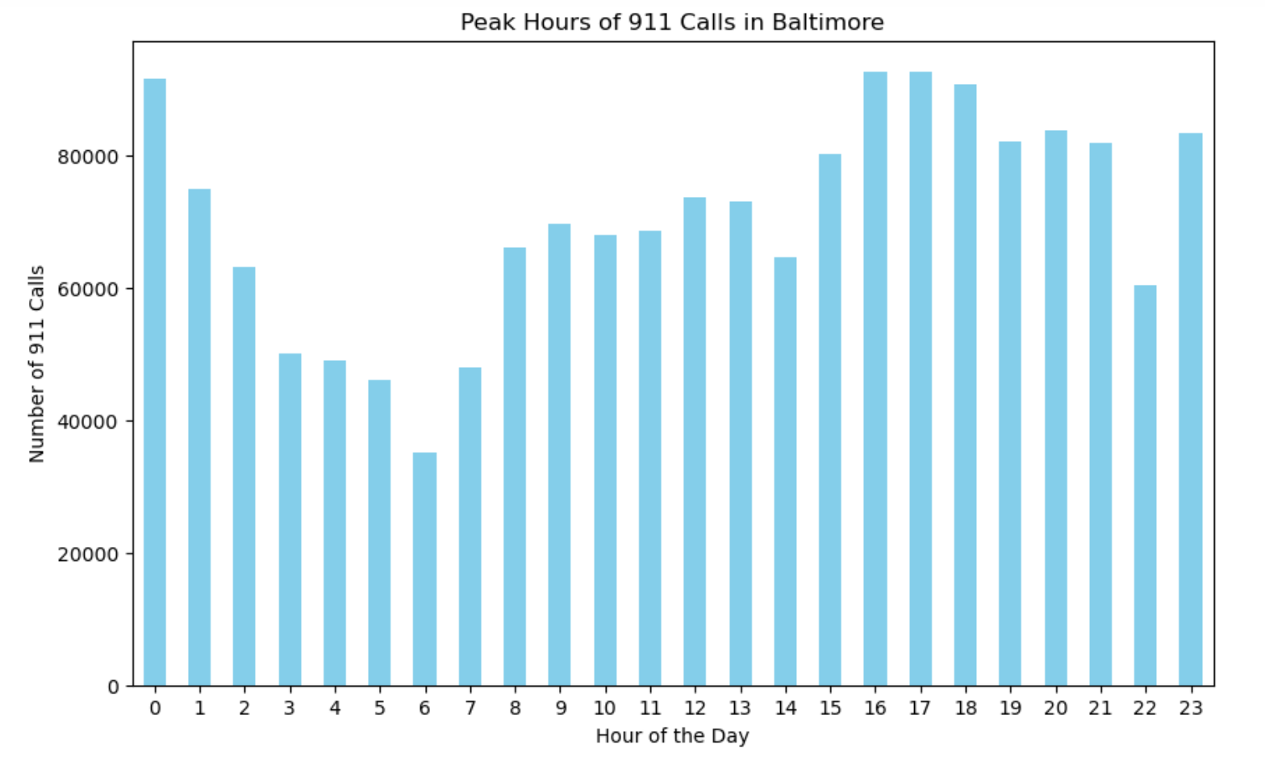
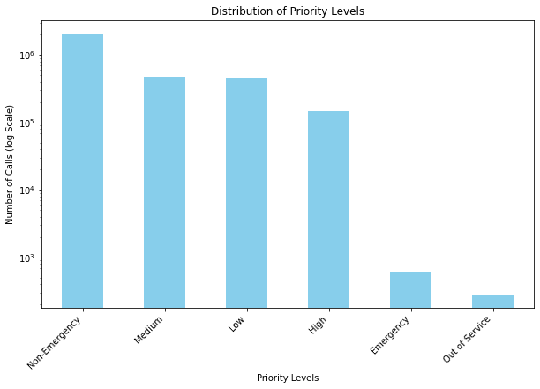
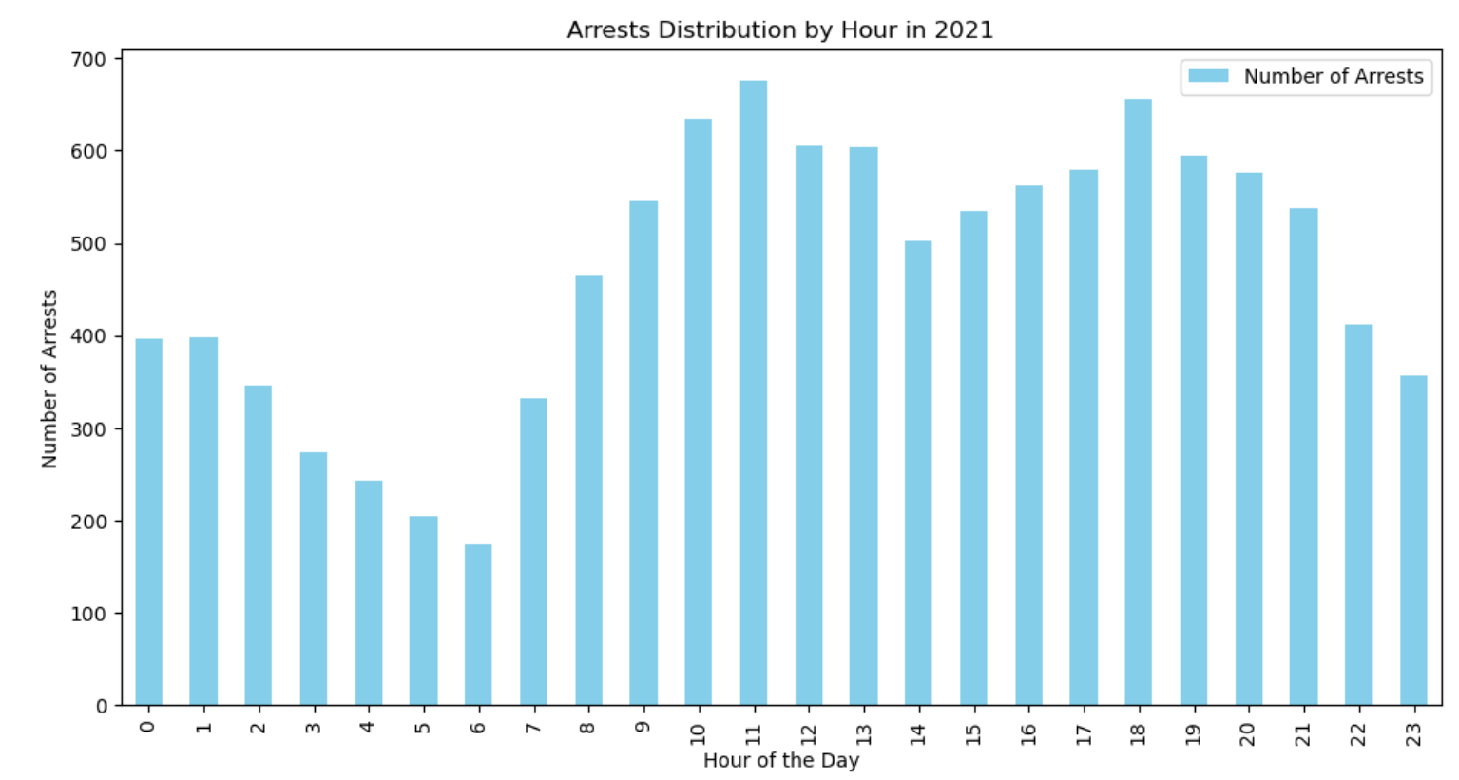
Deeper Analysis

Slide 6
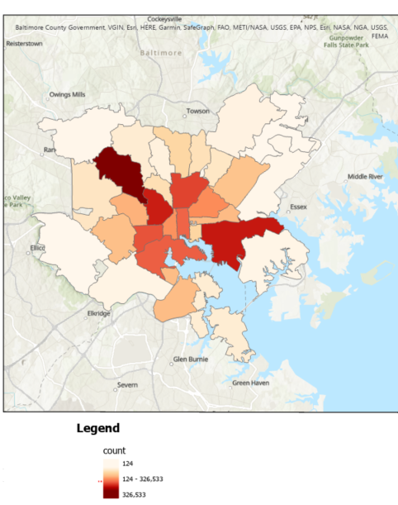
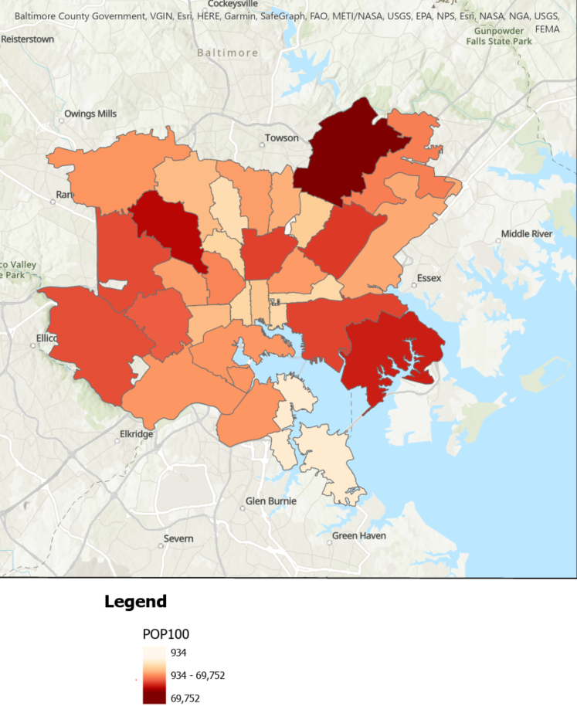
Maps -General Patterns
911 calls per zip code
Population per zip code
Each map is by zip code area
Map on left shows number of 911 calls since 2021 - dark colors show higher count
Map on right shows Population of each zip code
Maps do not take into consideration area of each zip code

Slide 7
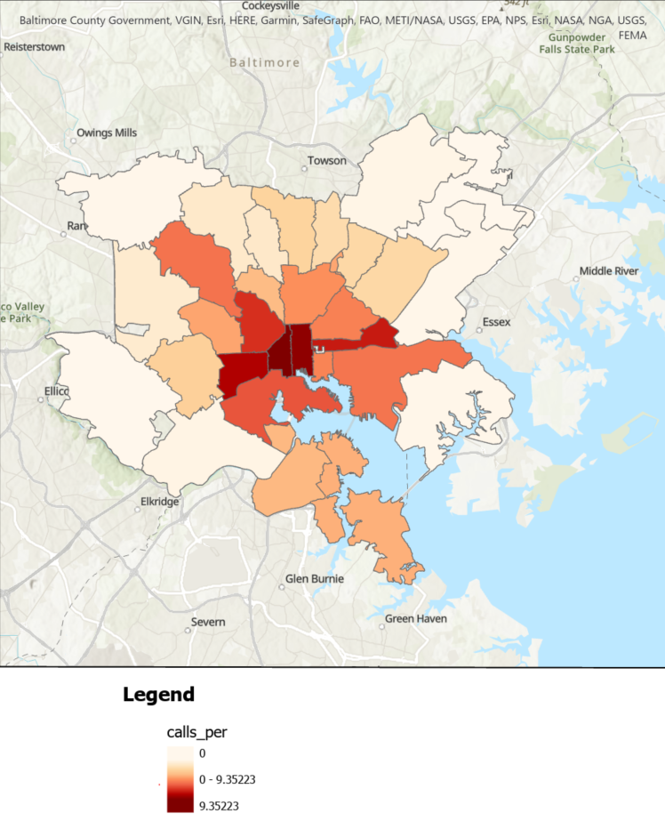
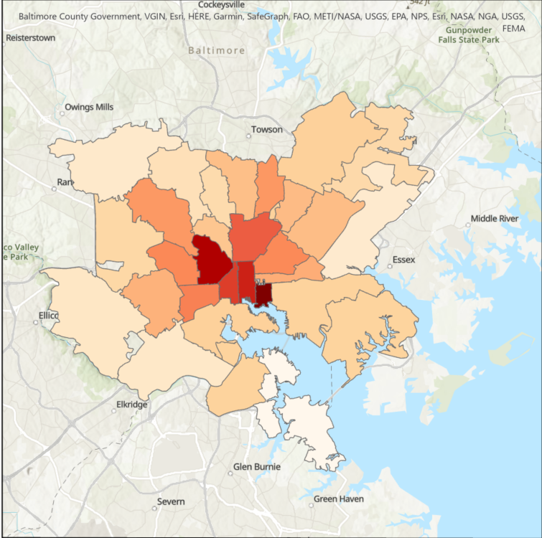
Maps(Normalized for Area)
911 Calls Per Person (Normalized for Area
Population (Normalized for Area
911 calls and population in each zip code
Left shows 911 calls once normalized for area
Right show population density
Correlation between 911 calls and population density

Slide 8
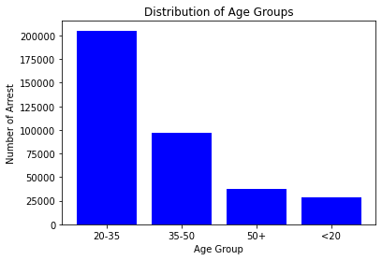
Arrest Data by Age
367,860 total Baltimore arrests from 2010 and 2022
Young and Middle-Aged adults seem to commit the most crime.

Slide 9
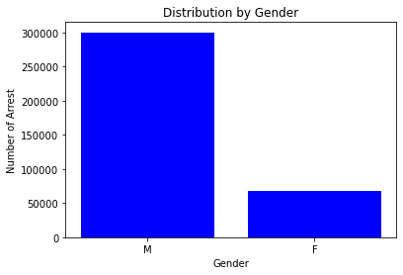
Arrest Data by Gender
Very large disparity with a 4 times difference!!
Potential gender related pattern in criminal behavior and law enforcement interactions.

Slide 10
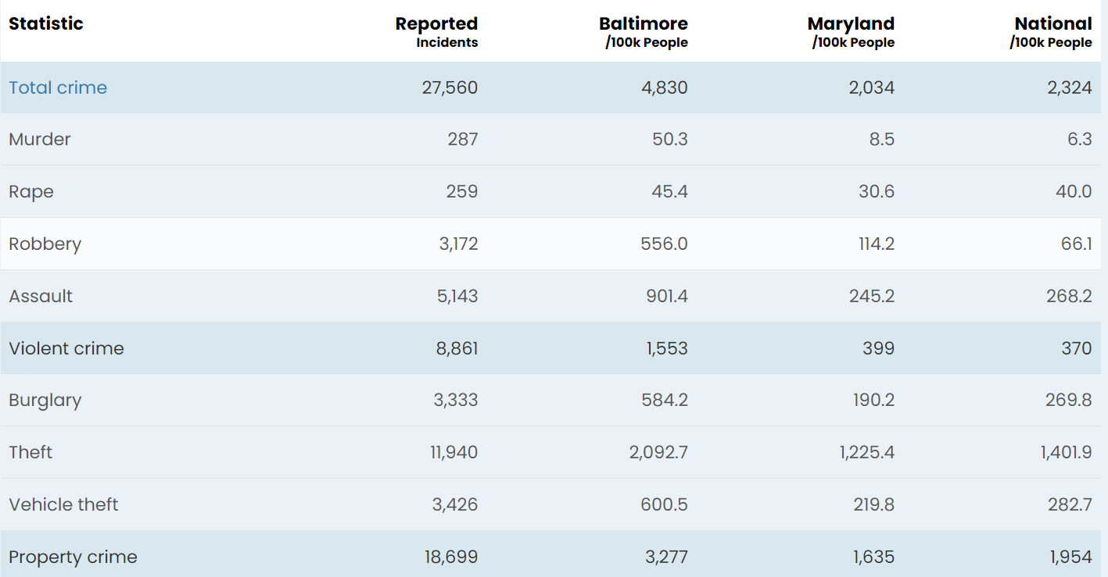
Crime Comparison
← FBI arrest data of 2022
Total crime → 108% higher than the national average
Violent crime → 320% higher than the national average
Property crime → 68% higher than the national average
Murder rate was eight times the national average!

Slide 11
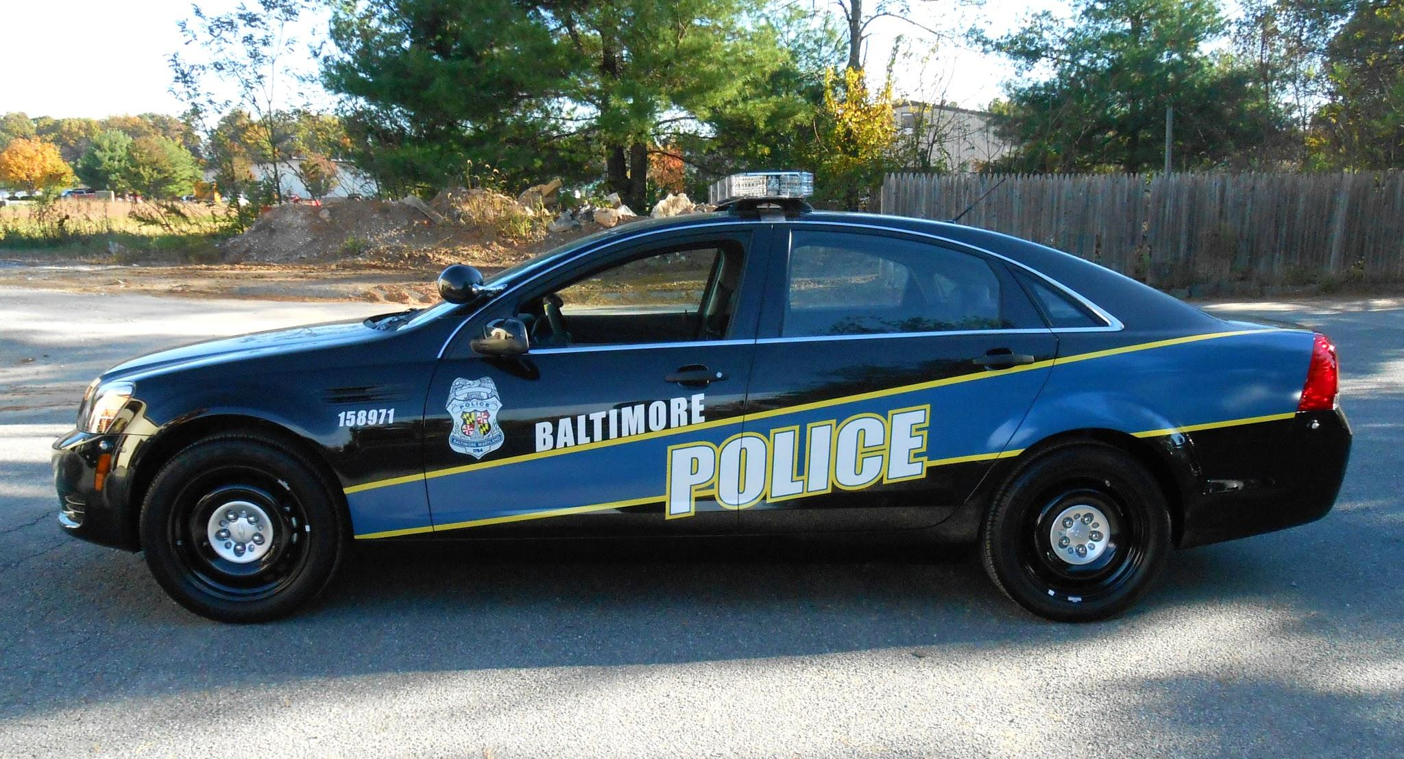
Suggestion for Policy and Government
Police Patrols in High-Call Volume Areas
  Increase police attendance in more targeted sectors of crime
    Include crime analyzation to find these higher targeted sectors
Mental Health and Social Services:
  Allowing for these types of services can decrease total crime committed
Data-Driven Policing
  Predicting crimes based on past crime data
Notes:
3. Promotes clear policies in ways that we can address these problems

Slide 12

Conclusion
Hypothesis
  Specific actions proposed
Call trends throughout the year
Peak Hours
Visualization of ARCGIS throughmaps
Demographic Correlation
Policy recommendations

Slide 13
Thank You For Listening!

